Slide 1
Cisco but fast
Really fast
Notes:
Pro tip: ask them questions, have them think abt them for a couple minutes, then ask for an answer. this helps u extend the time :D

Slide 2
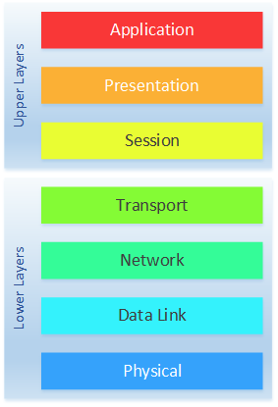
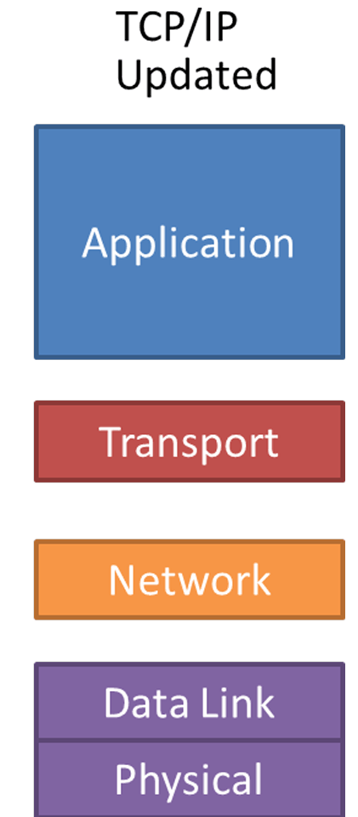
How does it work
OSI MODEL
TCP/IP
Notes:
TCP/IP is what the actual internet is based on, but the OSI model is a better conceptual model so when we teach its all gonna be with the OSI model. In cisco we are generally going to talk about the bottom 4 layers which are the same on both models because: [explain what each is]
Layer 7: What the end user interacts w
Layer 4: Coordination of data transfer
Layer 3: network to network (which takes a ROUTE between a BUNCH OF NODES)
Layer 2: Node to node
Layer 1: medium in which the data travels
ask them for examples of things they think could be on the different layers of TCP/IP

Slide 3
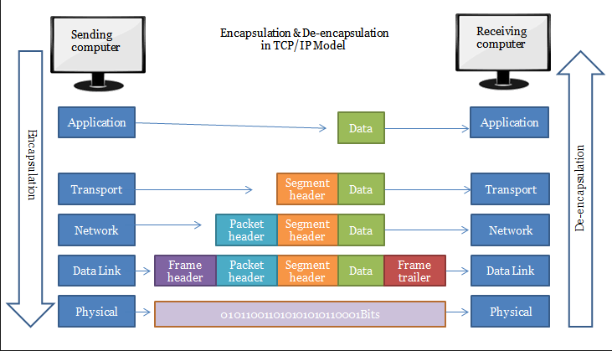
How does it work part 2
PDUs
PDUs are pieces of data called payloads encapsulated by headers (and footers sometimes)
Headers contain important metadata like IP addresses, MAC addresses, ports, etc
Layer 1: Bit
Layer 2: Frame
Layer 3: Packet
Layer 4: Segment

Slide 4
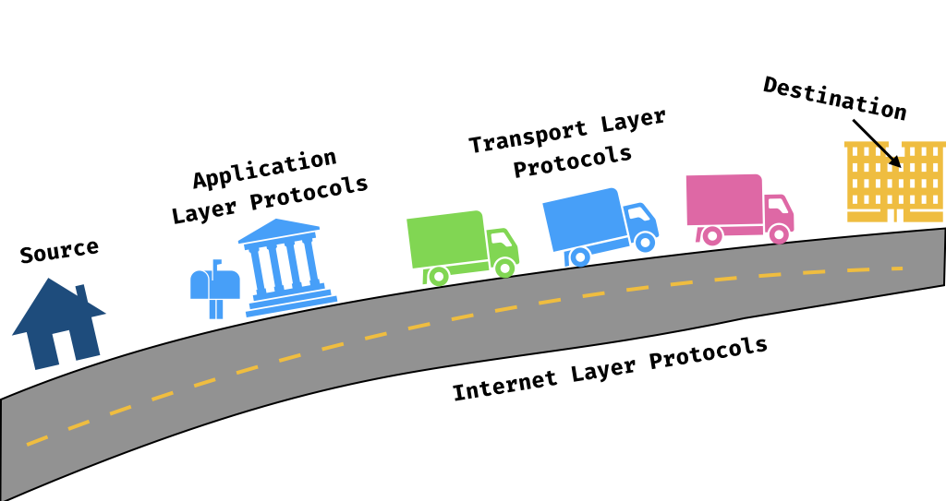
How it works part 3
Protocols
Protocols are rules that govern the data sent and received
Layer 1: IEEE 802.11, bluetooth
Layer 2: ARP, PPP
Layer 3: IP
Layer 4: TCP, UDP
Layer 5: NetBIOS
Layer 6: SSL/TLS
Layer 7: FTP, HTTP
Notes:
Why do we need protocols? What happens if we don’t have them?
introduce 0-5 as a protocol

Slide 5
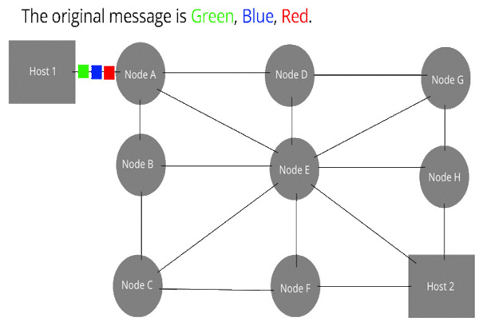
Fragmentation
Notes:
How are large chunks of information transmitted over the internet?
The message is broken into 3 packets: green, blue, and red. Each packet goes through a path that is determined to be the most efficient
When they arrive to their destination, they are reassembled. The headers are also taken off to just leave the raw data
What would happen if we didn’t break things down into smaller packets?

Slide 6

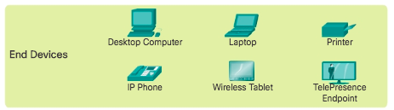
End Devices
Can be communicated with through their virtual ports
Ports are the doors to communicating with all devices
Lowest layer (layer 1)
The end node

Slide 7
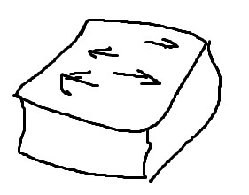

Switches
A step below routers and above end devices (layer 2)
Connects at a LAN level and forwards information to specific devices
Uses MAC addresses and switching protocols to figure out where to send PDUs
Notes:
Explain how hubs didnt think about where to forward stuff and thsu are obsolete because they are just bad.

Slide 8
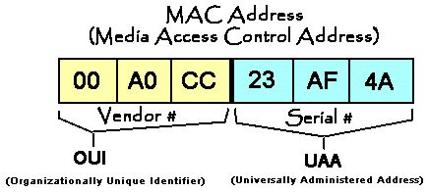
MAC Addresses
Also known as physical addresses
Used by switches on the data link layer (layer 2)
First 3 hex pairs are the OUI
Switches have MAC address tables, routers generally don’t
Notes:
Burned in address.

Slide 9
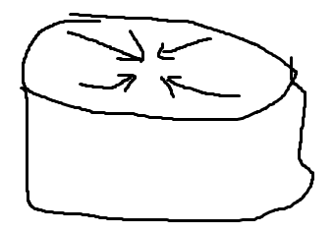
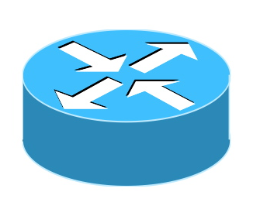
Routers
Layer 3
Connects everything at the highest level across long and/or short distance
Relies on IP addresses and routing protocols to figure out where to send PDUs
Most configuration of actual network interconnectedness occurs here (backbone of internet)
Notes:
Talk about what the internet is and how its just a bunch of connected routers. Operates on layer 3 and exlpain what pdus are

Slide 10
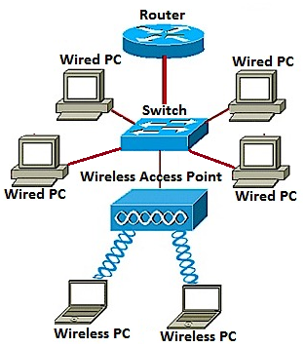
Access points
Devices that creates a WLAN
Connects to a wired router, switch, or hub through ethernet
Provides Wi-Fi signal for a certain area
Basically, allows people to wirelessly access the network
Notes:
WLAN: wireless LAN, not wide LAN lmao
The switches/routers are still the things that actually figure out which path to send packets. The access point just allows you to connect to those devices wo needing an ethernet cable

Slide 11
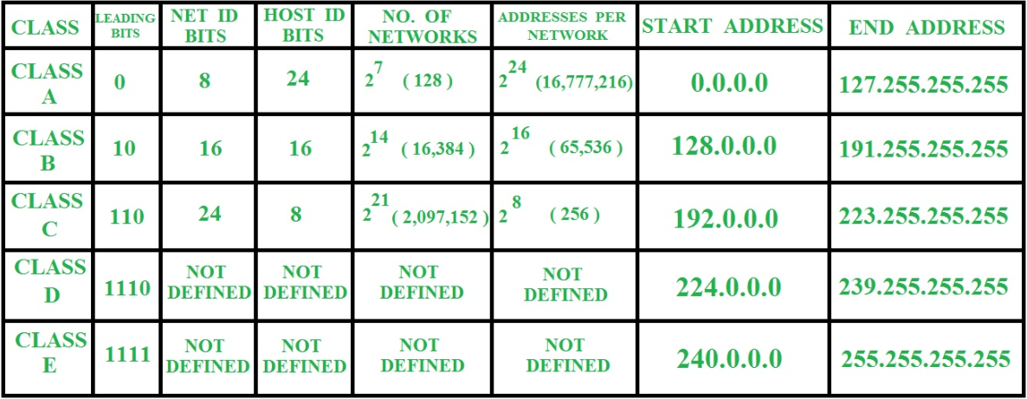
IPv4 addressing
Used for logical addressing
Groups devices into different networks
Each device has one so they can be reached by other devices across the internet
Classful addressing is how addresses were initially given out but it was inefficient
Notes:
Why do we need IPv4 addressing? How are computers supposed to talk to each other?(they need a way to refer to specific computers)
logical IP addressing: network section is kinda like a city and the host section is a specific area within that city.

Slide 12
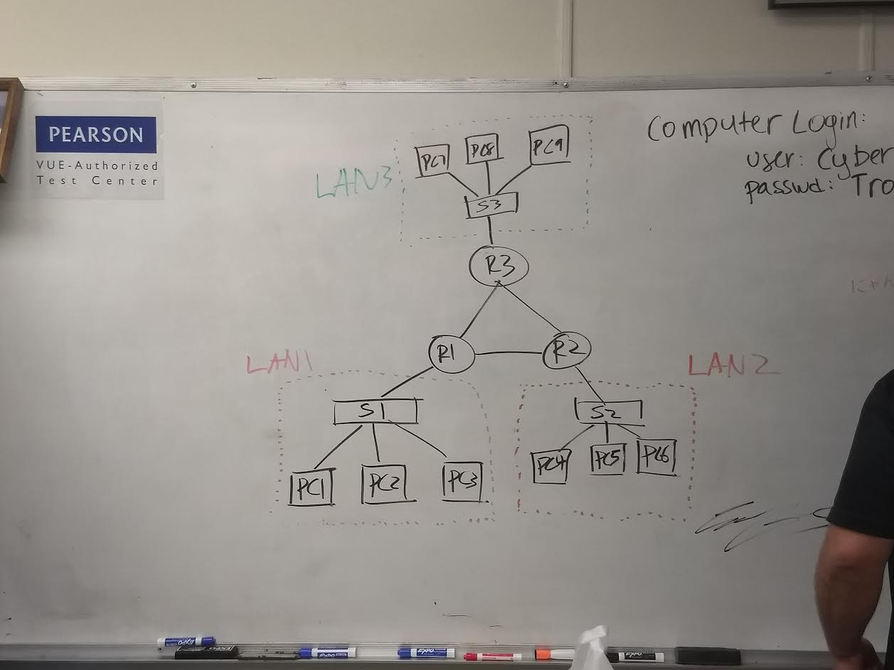
Switches vs Routers
Notes:
The switch defines the LAN. Because the mac addresses are not logical (not split into 2 parts) it must memorize each individual node
The routers connect the LANs. Each LAN uses IPs to define a network so the routers just memorize the networks, not each individual node on the network
Basically, the switches remember the individual nodes on the networks and the routers remember the general network themselves (thru the network portion of the IP) and therefore they route between the LANs
If the routers had to memorize the individual nodes on the networks, that would be too much computational power. Instead, we have the switches take those roles

Slide 13
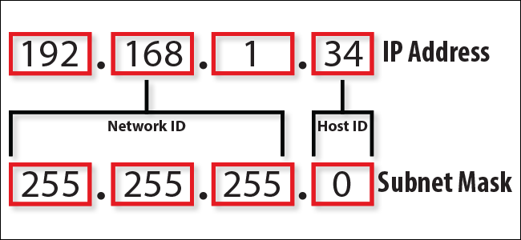
CIDR
CIDR is the new fancy way of giving addresses
Instead of having a set number of host bits (8,16,24), we can have any number between them denoted by /[#]
This saves a ton of addresses

Slide 14

Private
There's not enough IPv4 addresses so they made private
These are blocks reserved for reuse by organizations within their organization
Used with NAT to help preserve addresses
PRIVATE ADDRESSES
Notes:
Ask them to figure out how many IP addresses are possible w IPv4

Slide 15

NAT & PAT
NAT takes addresses and translates them to a usable form.
This means either public->private or private->public depending on the direction
It is to limit the amount of public addresses used by organizations
PAT does the same, but instead of being one address to one address, there can be many private addresses mapped to one public address using different ports.
Notes:
Network Address Translation

Slide 16
Routing Protocols
Internal
OSPF
RIP
EIGRP
How they work
These protocols look for the fastest way to get from one point to a final destination
They use different metrics, hop count vs “distance”

Slide 17
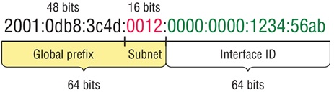
IPV6
This is what it looks like
Contiguous zeros can be replaced with double colon
Also split into network and host portions, just slightly more complex
Made because we ran out of ipv4 addresses
Slightly different, more concise header
Notes:
How many IP addresses are in IPv6?
IPv6 is simpler in terms of headers

Slide 18
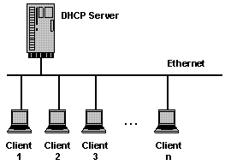
DHCP
Dynamic Host Configuration Protocol
Static IP:
You set it manually for a device
Dynamic IP:
A DHCP server assigns the IP and you don’t have to worry about it
Good for large infrastructures, where a network engineer would not want to do everything by hand
When would you want a static IP?
Notes:
Dynamic IP: when you connect to wifi, you pretty much never worry about your IP. There’s no prompt asking for your IP address.
You want a static IP for certain devices that you consistently need to access. For example, a printer. You always want to know where the printer is, so you reserve a static IP for it.

Slide 19
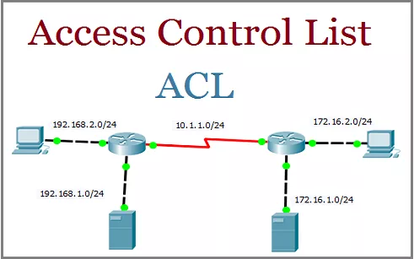
Access Control Lists (ACLs)
ACL: list of permit/deny statements (basically a firewall)

Slide 20
Different topologies
TYPES
Mesh
Star
Bus
Ring
Tree
GOALS
Hierarchical design – tiered approach used to simplify deployment, operation, and management
Modularity – allows for network expansion and adaptability
Resiliency – network must always be accessible
Flexibility – allows intelligent traffic load sharing by using all network resources

Slide 21
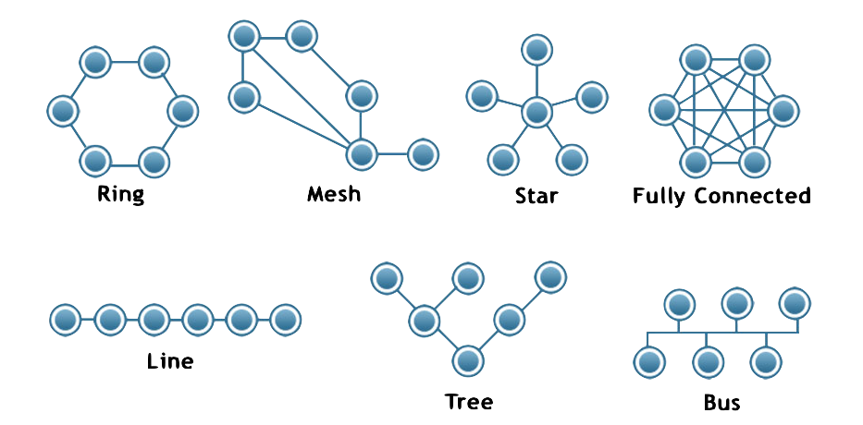
Network Topologies
Notes:
Ask them to point out pros/cons in each of them
https://www.webopedia.com/quick_ref/topologies.asp *Ryan: i dunno if this will help*

Slide 22
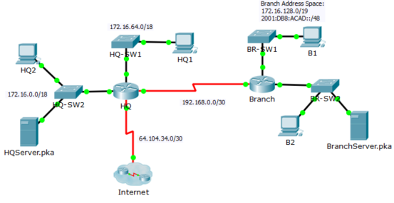
Example topology
Notes:
These are indiscriminate OS’s. Go over private/nonprivate ips.

Slide 23
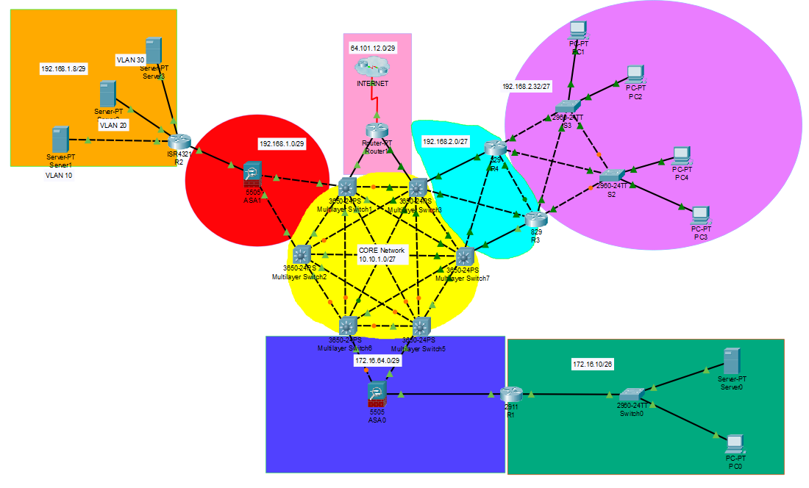
Slightly More complex topology
Notes:
Explain the 4 layers of the OSI model here starting at the bottom with layer 1 (PCs) to layer 2 (switch) through the firewall and to layer 3 (l3 switches).
go thru the different topology shapes that are in this

Slide 24
Kahooooot
https://create.kahoot.it/share/ciskahoot-yee/1ff75b87-b227-4994-a31e-dc40bcd12b8c

